Slide 1
BULLS-EYE
Target (objective)
Aim (key result)
SCORE (track)

Slide 3
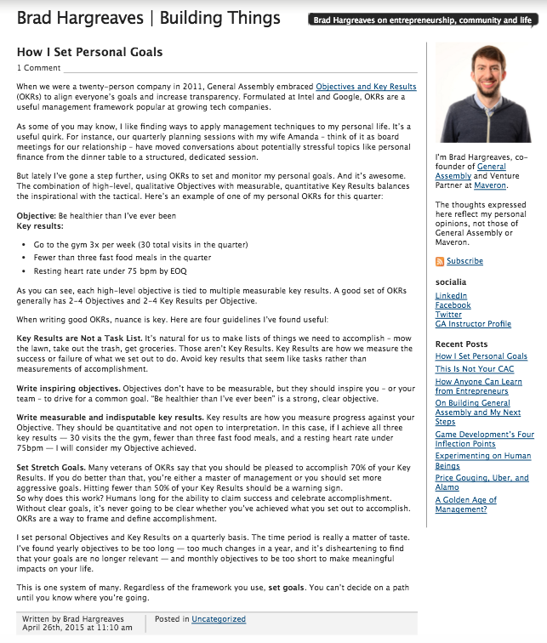
Brad’s 2015 Blog Post

Slide 4
TARGET
Qualitative Objectives: Inspirational
2-4/Quarter
Success or Failure measured by % Key Results achieved.
“Be healthier than I’ve ever been”

Slide 5
AIM
Quantitative Key Result: Measureable
2-4/Target
Tactical not tasks
30 visits to the gym
< 3 fast food meals
Resting hr < 75 bpm

Slide 6
SCORE
Quarterly Objectives
Long enough period of time to impact life
Periodic review
Graph/Chart status, list, entry display, edit
Daily input
Reminder
calendar
Photo
Location/weather

Slide 7
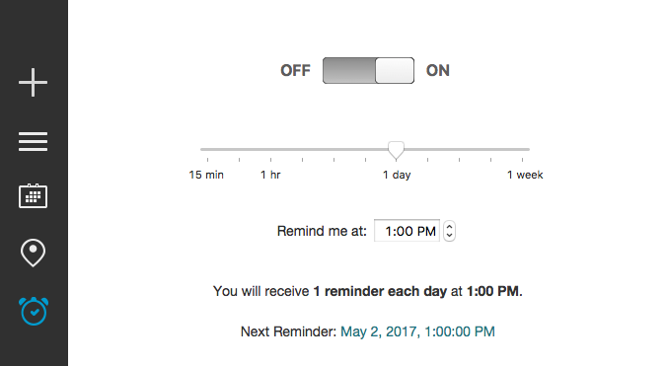
Set Reminder

Slide 8
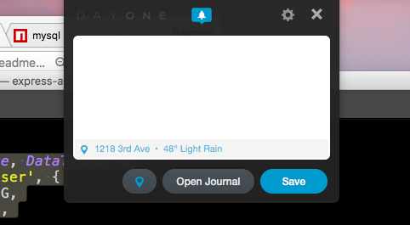
Reminder (Day One)

Slide 9
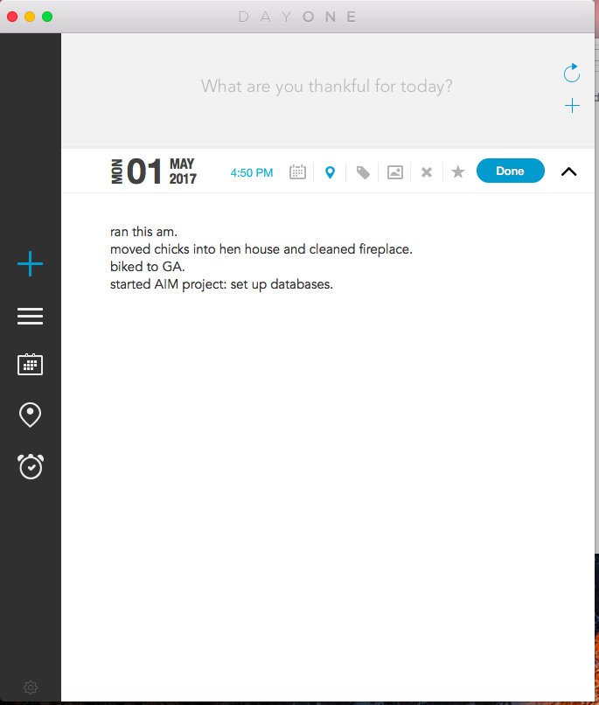
Create/Edit (Day One)

Slide 10
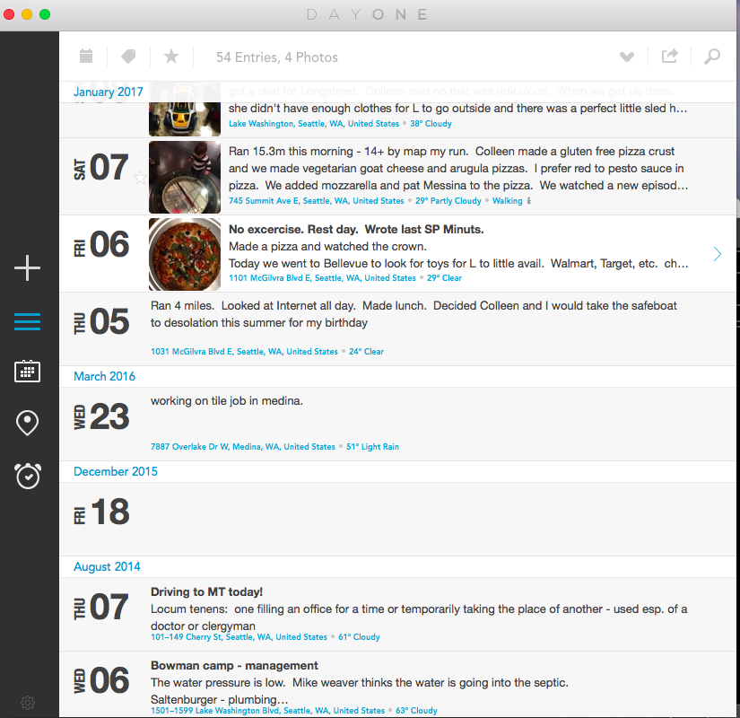
Review Posts

Slide 11
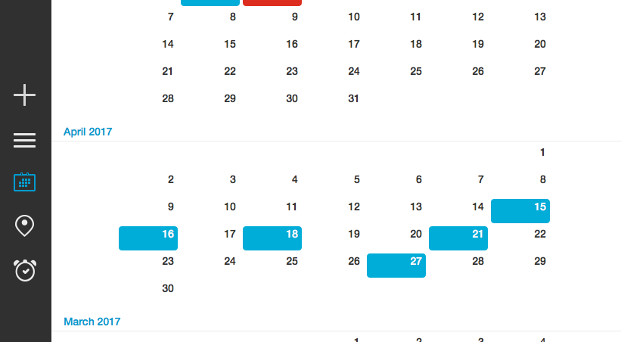
Quarterly Calendar Tracking

